Slide 1


Outlet Item Sales Prediction Model
- Jared Ahenkora-Kwakyi

Slide 2
Goal
The goal of utilizing my machine learning model is to predict the outlet item sales by measuring four key features
Outlet Type
Outlet Size
Item Visibility
Item MRP

Slide 3
Reasoning
Outlet Type – The type of store was important to me because I wanted to know if shoppers purchased more at supermarkets, grocery stores, or anything in between.
Outlet Size – Outlet size was important because I needed to know if shoppers purchased more at larger or smaller stores
Item MRP – The maximum retail price was important for each item because it helped determine the sales price of certain items which would be an important selling point for potential buyers.
Item Visibility – smaller items take up less space so shoppers be able to view more items which, I presume, would lead to more spending

Slide 4
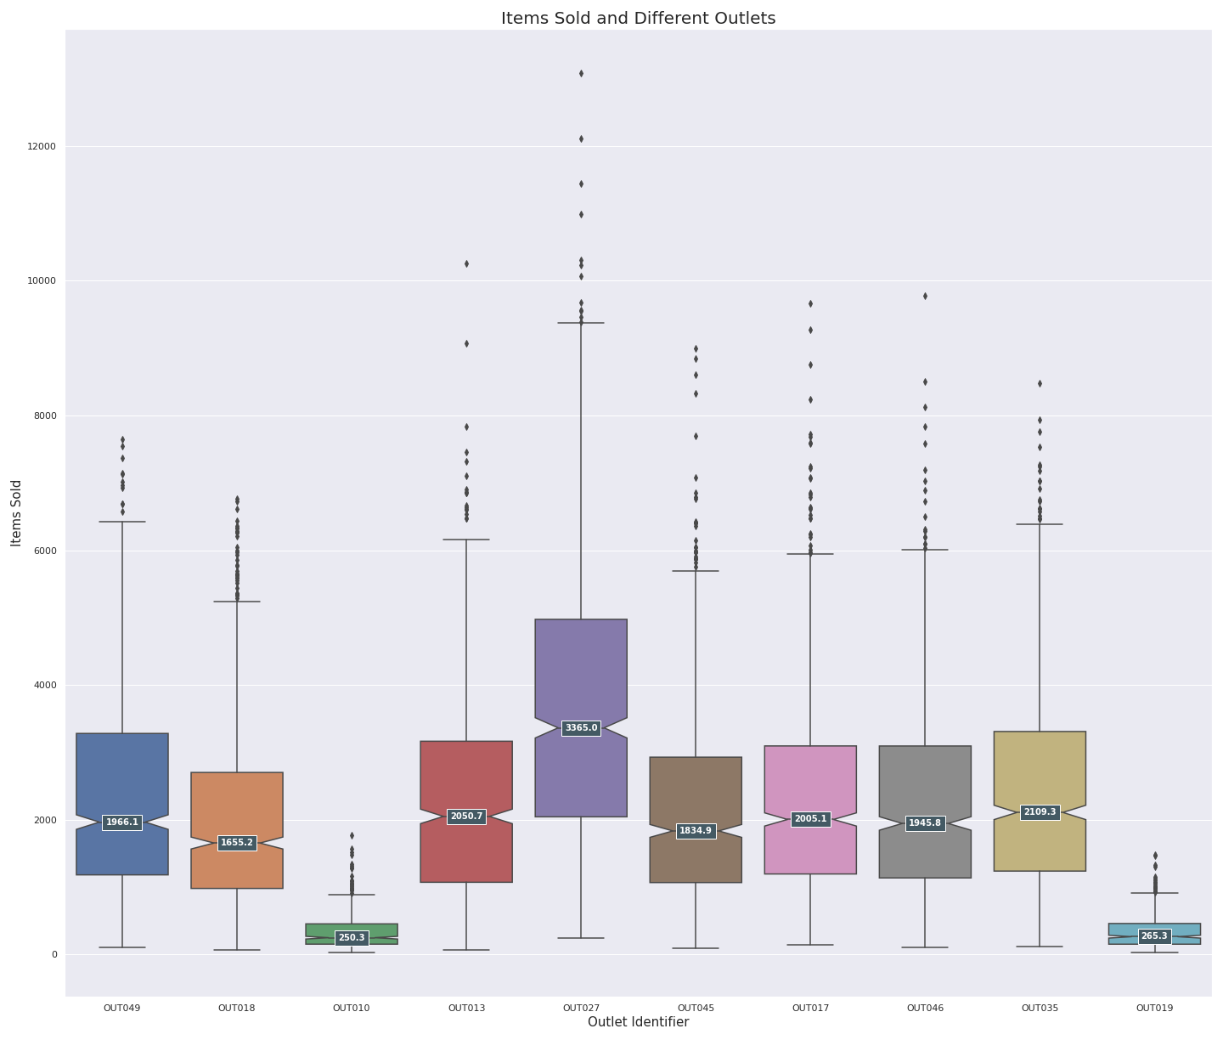
Highest Seller
Outlet 027
Had the most sales amongst all other outlets
I used this outlet as my baseline for modeling
Features include
Supermarket type 3 outlet type
Average Item Visibility
third lowest mean MRP
Medium size Outlet

Slide 5
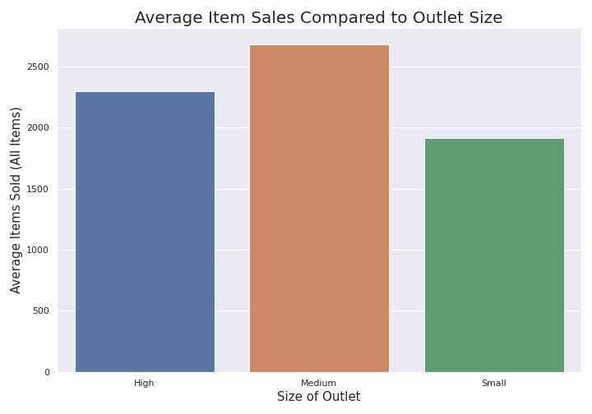
Outlet Size
We see here that Medium sized outlets outsell their competition on average.
Outlet 27 was the highest earning outlet and it was also a medium sized outlet

Slide 6
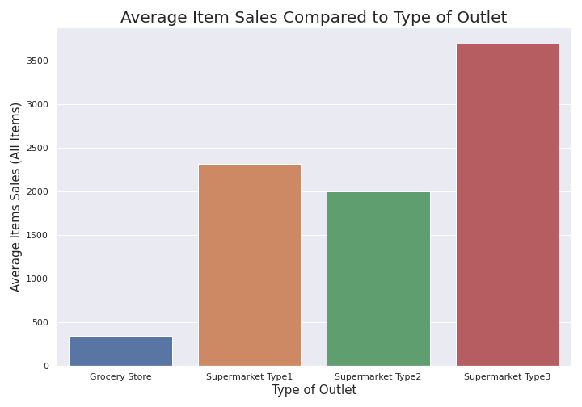
Outlet Type
The type of Supermarket an outlet was had a profound effect on the total sales.
Outlet 27 was a supermarket type 3

Slide 7
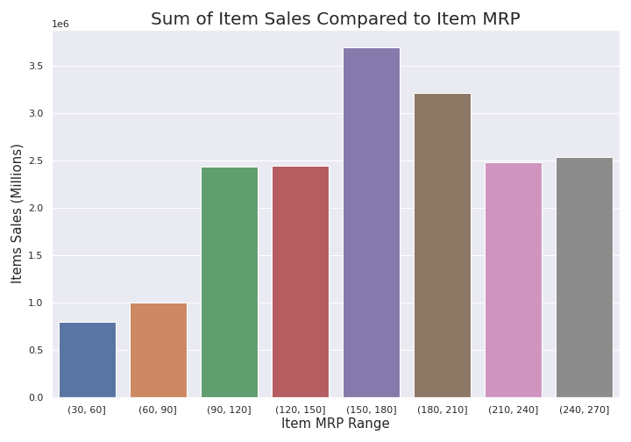
Item MRP
We see that items that have an MRP of $90+ bring in a larger sum of sales
The largest sum of sales came from items with an MRP ranging from $150-$210
Outlet 27 had an average item MRP of $139.80.

Slide 8
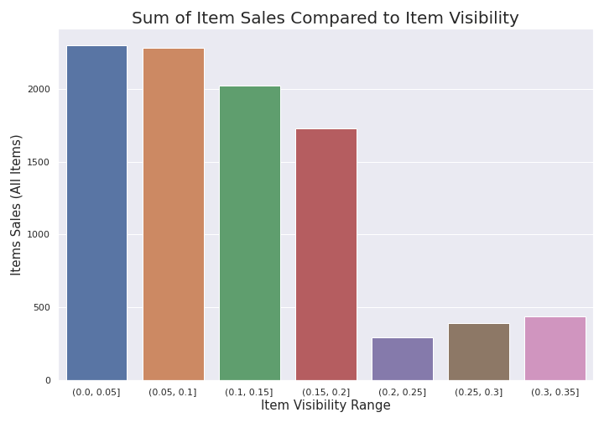
Item Visibility
Item visibility played a unique role because the larger the outlet, the smaller visibility percentage each item would have.
With that being said, as you can see on the graph, the smaller the item, the more sales they produced on average. This is possibly because people tend to buy smaller things in mass as opposed to larger things
Outlet 27 had an average item visibility of 6%.

Slide 9
Regression Tree Modeling r2 Train – 0.6039045881882898 r2 Test - 0.5947374340762479
Tuned my model to a max depth of 5 to get a less under-fit model which I was able to find.
I will need to tune my model a little more, but Regression tree model seems to be the best option.
The r2 indicates a positive correlation without too much overfitting which is what we were looking for with a 60%/59% accuracy split.
The accuracy of the predictions with this model show that utilizing Outlet size, outlet type, item visibility, and item MRP will help predict outlet item sales.

